Slide 1
THE BUSINESS OF TRANSLATION
A REWARDING CAREER OPTION
PRESENTED TO:
THE SPANISH HONOR SOCIETY OF
JOHN I. LEONARD HIGH-SCHOOL
SCHOOL DISTRICT OF PALM BEACH COUNTY
By: Anelly A. Schwab, MBA, ATA Certified Translator

Slide 2
THE TRANSLATION CAREER
THE FIELD OF TRANSLATION DATES BACK TO BIBLICAL TIMES….AND TODAY IT CONTINUES TO GROW
THERE ARE 6,500 LANGUAGES SPOKEN IN THE WORLD
MANDARING CHINESE IS AT THE TOP OF THE LIST
FOLLOWED BY SPANISH IN SECOND PLACE AND ENGLISH IN THIRD PLACE

Slide 3
A Very Brief History of Translation
According to EUGENE NIDA…
American pioneer, a PhD in Linguistics from the University of Michigan who regarded Translation as a “science”.
THE field of translation began with the translation of the Septuagint or the Old Testament from Hebrew to Greek (Soler Pardo, 2013:4).
The Septuagint has its origin in Alexandria, Egypt and was translated between 300-200 BC. The translation was completed by 72 translators (Soler, Pardo, 2013:4).
Late Latin Septuaginta, from Latin, seventy, irregular fromseptem seven + -ginta (akin to Latin viginti twenty); from the approximate number of its translators

Slide 4
EUGENE NIDA, an AMERICAN SCHOLAR
Eugene A. Nida was a linguist who developed the dynamic-equivalence Bible-translation theory and one of the founders of the modern discipline of Translation Studies. Wikipedia
Born: November 11, 1914, Oklahoma City, OK
Died: August 25, 2011
Spouse: Althea Sprague
Books: Contexts in Translating, Meaning across cultures
Education: University of California, Los Angeles, University of Southern California,University of Michigan

Slide 5
The History of Translation and Ancient Times….
Even before the translation of the Old Testament, Tullius Cicero who translated texts around 106-43 BC, used two translation techniques, a ‘word for word’ translation and a ‘sense for sense’ translation (Soler Pardo, 2013: 4).
According to Cicero, one should not translate ‘word for word’ and long after he said this, another scholar by the name of Peter said that the main problem of translating a text was whether to translate “literally” or “freely” (Soler Pardo, 2013:4)

Slide 6
Marcus Tullius Cicero, a scholar and pioneer in Translation (time: Antiquity)
Roman Politician
Marcus Tullius Cicero, was a Roman philosopher, politician, lawyer, orator, political theorist, consul and constitutionalist. Wikipedia
Born: January 3, 106 BC, Arpinum, Rome
Assassinated: December 7, 43 BC,Formia, Italy
Spouse: Terentia (m. 79 BC–51 BC)
Children: Tullia Ciceronis, Cicero Minor
Parents: Marcus Tullius Cicero, Helvia Cicero
He made a distinction between literal translation and free translation

Slide 7
Other Thinkers who dealt with Translation and help shape it…
Roman lyric poet, satirist, and critic Horace (Quintus Horatius Flaccus) was born in Apulia, Italy, in 65 B.C. His father, an Italian Freedman, sent Horace to the finest school in Rome The Grammaticus Orbilius
Horace is best known today for his Odes, which often celebrate common events such as proposing a drink or wishing a friend a safe journey.
“Horace advises poets to read widely, to strive for precision, and to find the best criticism available”

Slide 8
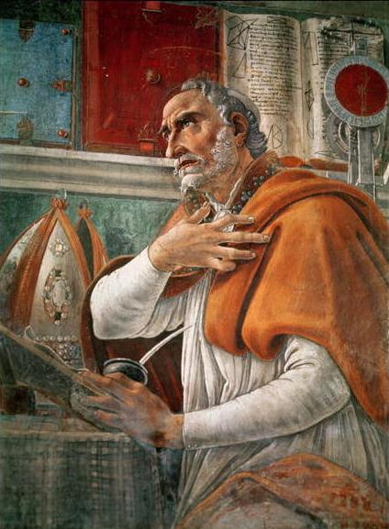
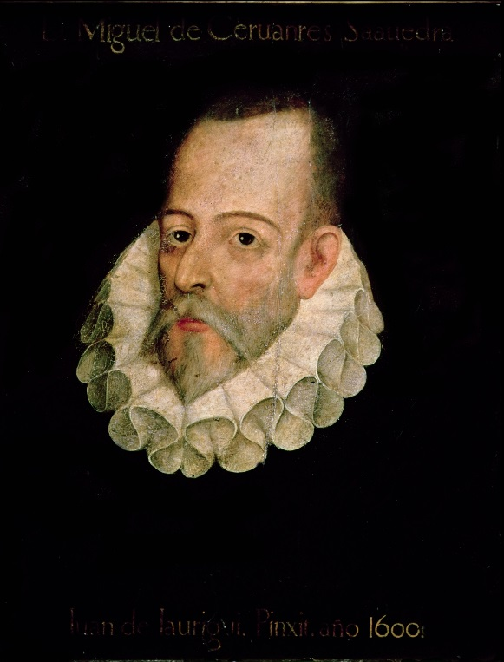
Our Patron Saint and Other Thinkers who help shape the Study of Translation…
Saint Augustine of Hippo
Augustine, a theologian in the 4th century, is considered an influential figure in the history of education
He wrote “Confessions” and many other moralistic and religious works.
Augustine introduced the idea of teachers responding positively to the questions they may receive from their students, no matter if the student interrupted the teacher.
Miguel de Cervantes Saavedra a 16th Century playwright, novelist, and poet who wrote in Castilian Spanish. His novel “Don Quijote de la Mancha” has been translated into all major languages and has appeared in 700 editions.
Patron Saint of Translators
Translating in the 4th Century much of what became the Latin Vulgate Bible (the “official” Bible translation) would take many years and be his most important achievement.

Slide 9
Translation in Modern Times
In the 80’s and up until his recent death in 2011, British scholar Peter Newmark, developed and advocated a “new theory of translation” which is still taught in many University classrooms in Great Britain and in Spain (Pym, Anthony 1992).
In his book, “About Translation”, he proposed the concept that translation is both “communicative” and “semantic” and that they are not separate from each other.

Slide 10
PETER NEWMARK – “About Translation”
Taught in Classrooms Today
SCHOLAR AND TRANSLATION THEORIST
Developed a highly discussed Theory of Translation: Basically, he advocates that translation should be based on the Author’s purpose and intent, but as long as is “communicative”.
He also made the distinction between Translation as an activity that follows rules (of grammar and syntax), and Language which is formed and evolutions by the “breaking of rules” and by “new ideas”.
So where the author innovates, the translator follows. With culture specific language, the translator is free to be creative
Peter Newmark was an English professor of translation at the University of Surrey.Wikipedia
Born: 1916, Brno, Czech Republic
Died: 2011
Books: Approaches to translation, About translation

Slide 11
EMERGENCE OF “TRANSLATION STUDIES”: or “Traductología” from Russian Structuralism
It began with James Holmes around 60 years ago (Soler Pardo, 2013: 10). In Spanish, it was given the name of Traductología
HOLMES
FROM LANGUAGE LEARNING
LEFEVRE
PRAGMATIC APPROACH
OUTLINED DIFFERENT METHODS OF TRANSLATION FOR THE SAME TEXT
BASSNET
THERE IS NO SINGLE WAY OF TRANSLATING TEXT
NEED TO NEGOTIATE BETWEEN LANGUAGE AND CULTURE
TO A FIELD OF ACADEMIC INVESTIGATION
(Belgium, 1945 – USA, March 27, 1996)
U.K. 1945 - Present
U.S. Scholar
1924-1986
Russian Structuralism: a literary movement in Russia in the 20th Century whose scholars believed that a literary text has to be considered by itself based on its intrinsic qualities.

Slide 12
Professor Susan Bassnett: Scholar, Author of Translation Studies
Professor of Comparative Studies at the
University of Warwick, London, England
She was influenced by Russian Structuralism
Susan Bassnett published a book in 1980 and more recently in 2014, “Translation Studies” with the main two propositions:
There is no single way of translating a text.
The translation must be based on comparing the functionality of the Source language with the functionality of the Target language.
Also, she appears to include the same “cultural” implications than others such as Lefebvre and even Peter Newmark had.
“I see translation as a vitally important activity in today’s world but I do not see it as straightforward linguistic transfer, rather as a complex process of negotiation between languages and cultures” –Susan Bassnett

Slide 13
TRANSLATION STUDIES AT THE PRESENT TIME
The field of Translation Studies is well-consolidated and during the past 30 years or so five distinct approaches have emerged: (Soler Pardo, 2013: 15)

Slide 14
FIVE APPROACHES TO TRANSLATION STUDIES
LINGUISTIC APPROACH
TEXTUAL APPROACH
PHILOSOPHICAL AND HERMENEUTIC APPROACH
COMMUNICATIVE AND SOCIOCULTURAL APPROACH
COGNITIVE APPROACH

Slide 15
Some Strategies and Procedures used in TRANSLATION in the 2000s
TRANSLATION STRATEGIES:
FREE TRANSLATION
IDIOMATIC TRANSLATION
FUNCTIONAL TRANSLATION
LITERAL TRANSLATION
TRANSLATION PROCEDURES:
ACCULTURATION
DIRECT TRANSFER
INTERPRETATION
PARAPHRASE
ADDITION
OMISSION
Source: www.routeledgetranslationstudiesportal.com

Slide 16
THE TRANSLATION CAREER
According to the U.S. Bureau of Labor Statistics the translation career occupies the third place of the ten fastest growing occupations for college graduates through 2020.
Translators and Interpreters will see a 46% increase in employment through 2020, much faster than the average of all occupations. The median annual wage for interpreters and translators was $45,430 in May 2012.
Source: http://www.bls.gov/ooh/media-and-communication/interpreters-and-translators.htm

Slide 17
THE WORK OF TRANSLATORS
Interpreters and translators convert information from one language into another language. Interpreters work in spoken or sign language; translators work in written language.
Interpreters work in schools, hospitals, courtrooms, and conference centers. Many translators work from home. Self-employed interpreters and translators frequently have variable work schedules. Most interpreters and translators work full time during regular business hours.

Slide 18
TRANSLATION SKILLS
Translation skills
Information Technology
Making Decisions
Communication
Language and Literacy
Project Management
Cultural Understanding
Source: Geoffrey Samuelsson-Brown

Slide 19
If you wish to become a translator then…
These are desirable requirements:
Attain your basic degree in modern languages or linguistics
Spend some time in the country where the language of your choice is spoken
Complete a postgraduate course in translation studies
Gain some knowledge or experience of the subjects you intend to translate
Get a job as a trainee or junior translator with a company
Learn to type!
Be willing to commit to lifelong learning!
Source: Geoffrey Samuelson-Brown

Slide 20
WORKING AS A FREELANCE TRANSLATOR
DETERMINE HOW MUCH YOU WANT TO WORK: PART TIME OR FULL TIME?
TRANSLATION CAN BE MENTALLY TAXING…TAKE BREAKS AND REST….
BECOME A MEMBER OF THE AMERICAN TRANSLATORS ASSOCIATION, ATTEND THE CONFERENCES, MEET OTHER PROFESSIONALS IN THE FIELD
READ, READ, READ, IN BOTH LANGUAGES
SPECIALIZE IN AREAS WITHIN YOUR LANGUAGE PAIR – CHOOSE YOUR NICHE
STUDY AND GET CERTIFIED BY THE AMERICAN TRANSLATORS ASSOCIATION IN YOUR LANGUAGE DIRECTION OF CHOICE

Slide 21
LANGUAGE PAIR: SOURCE VS. TARGET LANGUAGE
IN TRANSLATION, THE SOURCE LANGUAGE IS THE LANGUAGE FROM THE ORIGINAL DOCUMENT
THE TARGET LANGUAGE IS THE LANGUAGE IN WHICH THE DOCUMENT IS TRANSLATED
TRANSLATORS OBTAIN CERTIFICATIONS IN LANGUAGE PAIRS
THE AMERICAN TRANSLATORS ASSOCIATION OFFERS AN EXAM IN A VARIETY OF LANGUAGE PAIRS
MY ATA CERTIFICATION IS IN ENGLISH(SOURCE) TO SPANISH (TARGET)
ONLY 20% OF TEST TAKERS ACTUALLY PASS THE ATA EXAM.

Slide 22
The American Translators Association: a Great Start!
ATA is a professional association founded to advance the translation and interpreting professions and foster the professional development of individual translators and interpreters.
Its 11,000 members in more than 90 countries include translators, interpreters, teachers, project managers, web and software developers, language company owners, hospitals, universities, and government agencies.
Association membership is available to individuals (Active, Corresponding, Associate, Student) and organizations (Corporate, Institutional).
For more information:
http://www.atanet.org/aboutus/about_ata.php

Slide 23
Top Translation Certification Programs:
Boston University
FIU
Georgia State University
NYU
Boston University offers professional certificates in community, legal, and medical interpreting with specializations in Chinese, Portuguese, and Spanish. The program focuses on the linguistic techniques and ethical considerations of the interpreting profession, and organizes students in Cohort Groups based on their language specialization.
Located in Miami, Florida International offers a Certificate in Translation Studies (English / Spanish) and certificate in Legal Translation and Court Interpreting (English / Spanish). Established in 1980, the program offers classes in the evenings and weekends, and allows students to take up to five courses before making a commitment.
Located in Atlanta and established in 1980, Georgia State University’s Translation Certificate Program offers specializations in French, German, and Spanish translation, as well as French and Spanish Interpreting for medical, legal, and conference interpretation. The program consists of 15 semester hours which include classes in comparative stylistics, general and advanced translation, and a translation workshop.
NYU offers professional certificates in general translation, medical interpreting, court interpreting (Spanish/English), simultaneous interpreting, and general language studies certificates in Arabic, Japanese, Mandarin, Italian, Greek, Portuguese, Russian, Spanish, and language groups such as Slavic, East Asian, Middle Eastern, Scandinavian, and Classical languages.
Source: http://www.altalang.com/beyond-words/2009/09/23/top-10-us-translation-schools/

Slide 24
References
Bell, Tony. “Peter Newman Obituary”. The Guardian. Retrieved from http://www.theguardian.com/education/2011/sep/28/peter-newmark-obituary, 09/28/2011
Newmark, Peter (1991) About Translation, Great Britain: Cromwell Press Ltd. Retrieved from http://books.google.com/
Pardo, Betlem Soler. "Translation Studies: An Introduction to the History and Development of (Audiovisual) Translation." LINGUAX (2013). Retrieved from http://www.uax.es/publicacion/translation-studies-an-introduction-to-the-history-and-development-of.pdf
Pym, Anthony. “La enseñanza de la traducción y la teoría autoritaria de Peter Newman”, (1991) Retrieved from http://acceda.ulpgc.es/xmlui/handle/10553/5020
http://gbgm-umc.org/umw/bible/translations.stm#Vulgate
http://en.wikipedia.org/wiki/Eugene_Nida
http://nptel.ac.in/courses/109104050/lecture9/9_7.htm
http://en.wikipedia.org/wiki/Augustine_of_Hippo#mediaviewer/File:Saint_Augustine_Portrait.jpg
http://www.poets.org/poetsorg/poet/horace
http://en.wikipedia.org/wiki/Miguel_de_Cervantes
http://www.altalang.com/beyond-words/2009/09/23/top-10-us-translation-schools/
http://cw.routledge.com/textbooks/translationstudies/data/samples/9780415584890.pdf
Atanet.org
Cover image only: Jobes, K., Silva, M. (2000) Invitation to the Septuagint, Baker Academy Retrieved from http://books.google.com

